Slide 2
World Missionary Press
GFA Prayer Time
November 19, 2013

Slide 3
Luke 12:29-34
²⁹ “And do not seek what you should eat or what you should drink, nor have an anxious mind. ³⁰ For all these things the nations of the world seek after, and your Father knows that you need these things. ³¹ But seek the kingdom of God, and all these things shall be added to you.
³² “Do not fear, little flock, for it is your Father’s good pleasure to give you the kingdom. ³³ Sell what you have and give alms; provide yourselves money bags which do not grow old, a treasure in the heavens that does not fail, where no thief approaches nor moth destroys. ³⁴ For where your treasure is, there your heart will be also.

Slide 4
Francophone Africa Shipments
4,167 4,215 4,246 968 2,369 4,215 2,140 2,318 1,922 1,358 1,424 917 1,881 2,220 1,209 35,569 |  | Central African Republic (CAR) Democratic Republic of the Congo (RDC) Mali Niger Guinea Republic Côte d’Ivoire (Ivory Coast) Chad Senegal Burkina Faso Gabon Benin Congo Republic (Brazzaville) Togo Cameroon Equatorial Guinea Total Boxes; 17,784,500 equivalency

Slide 5
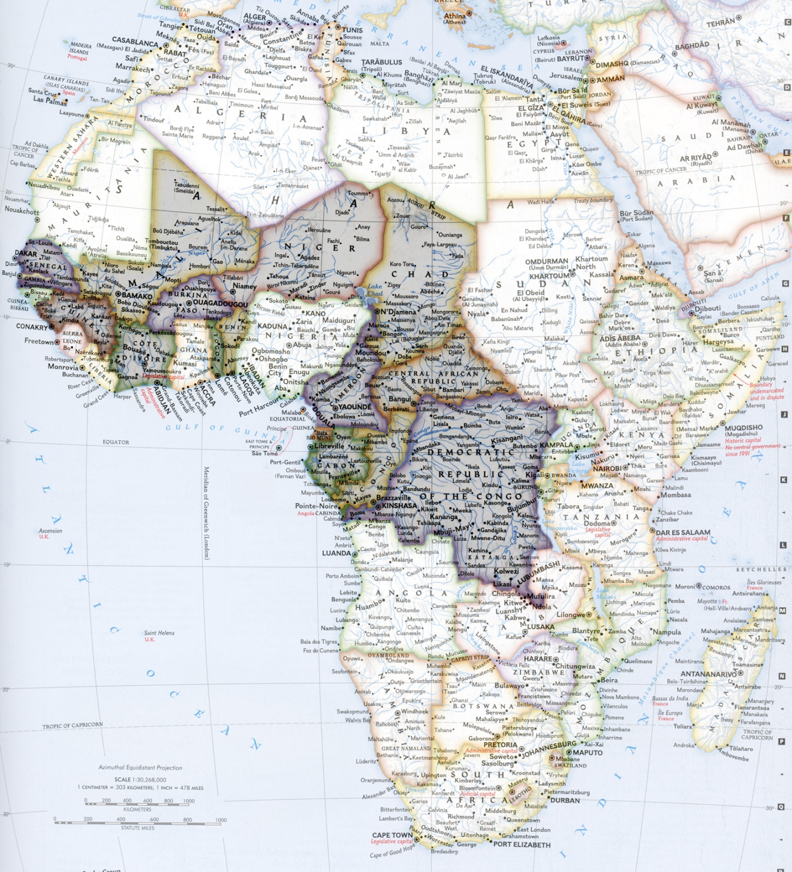

Slide 6
Luke 11:21-22
²¹ When a strong man, fully armed, guards his own palace, his goods are in peace.
²² But when a stronger than he comes upon him and overcomes him, he takes from him all his armor in which he trusted, and divides his spoils.

Slide 7
Prayer Topics:
God’s Presence and Direction;
Wisdom;
Fruit in French Africa;
Release of Gabon container;
Printings in India;
Income for producing and sending more Scripture;
Bindery equipment, needed for increasing production;
Personnel (God’ choice and leading):
Apprentice pressman;
Accounting person;
Bindery operator;

